Slide 1
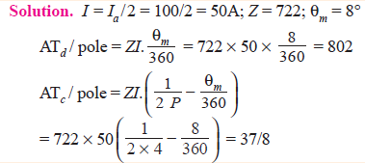
Example-1
A 4-pole generator has a wave-wound armature with 722 conductors, and it delivers 100 A on full load. If the brush lead is 8°, calculate the armature demagnetising and cross-magnetising ampere turns per pole.

Slide 2
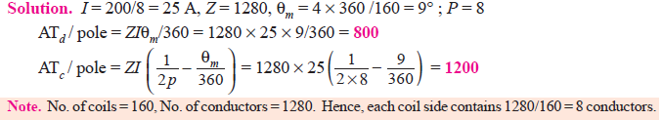
Example - 2
An 8-pole generator has an output of 200 A at 500 V, the lap-connected armature has 1280 conductors, 160 commutator segments. If the brushes are advanced 4-segments from the no-load neutral axis, estimate the armature demagnetizing and cross-magnetizing ampere-turns per pole.

Slide 3
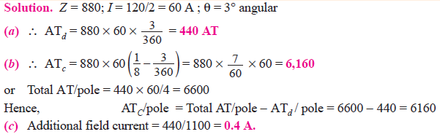
Example - 3
A 4-pole wave-wound motor armature has 880 conductors and delivers 120 A. The brushes have been displaced through 3 angular degrees from the geometrical axis. Calculate (a) demagnetising amp-turns/pole (b) cross- magnetising amp-turns/pole (c) the additional field current for neutralizing the demagnetisation of the field winding has 1100 turns/pole.

Slide 4
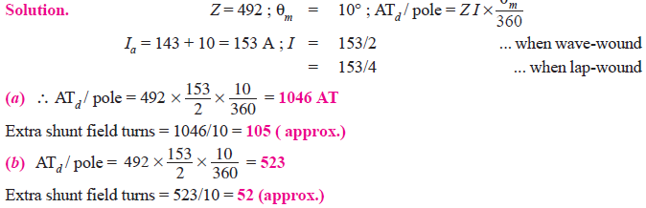
Example - 4
A 4-pole generator supplies a current of 143 A. It has 492 armature conductors (a) wave-wound (b) lap-wound. When delivering full load, the brushes are given an actual lead of 10°. Calculate the demagnetising amp-turns/pole. This field winding is shunt connected and takes 10 A. Find the number of extra shunt field turns necessary to neutralize this demagnetisation.

Slide 5
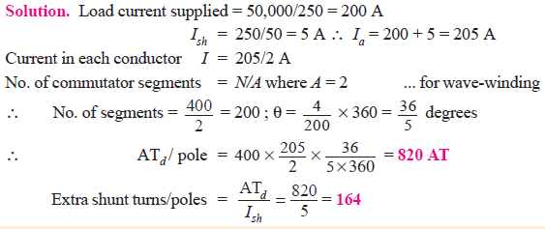
Example - 5
A 4-pole, 50-kW, 250-V wave-wound shunt generator has 400 armature conductors. Brushes are given a lead of 4 commutator segments. Calculate the demagnetisation amp-turns/ pole if shunt field resistance is 50 Ω. Also, calculate extra shunt field turns/pole to neutralize the demagnetisation.

